Slide 1




Sets, Hash table, Dictionaries
Sets, Dictionaries
Advanced C#
SoftUni Team
Technical Trainers
Software University
http://softuni.bg

Slide 2

Table of Contents
Sets
HashSet<T>
SortedSet<T>
Hash Table
Dictionaries
Dictionary<K, V>
SortedDictionary<K, V>

Slide 3
Questions
sli.do #CSharp-Advanced

Slide 4
Sets
3
7
-3
5
46
HashSet<T> and SortedSet<T>

Slide 5
Sets in C#
A set keep unique elements
Provides methods for adding/removing/searching elements
Offers very fast performance
HashSet<T>
The elements are randomly ordered
SortedSet<T>
The elements are ordered incrementally

Slide 6
HashSet<T> – Add()
HashSet<string>
Pesho
Pesho
Hash Function
Alice
Gosho

Slide 7
HashSet<T> – Remove()
HashSet<string>
Pesho
Gosho
Hash Function
Alice
Alice

Slide 8
SortedSet<T> – Add()
SortedSet<string>
Pesho
Pesho
Alice
Gosho

Slide 9
Problem: Parking Lot
Write a program that:
Record car number for every car that enter in parking lot
Remove car number when the car go out
Car
Parking Lot
CA4466GA
CA2844AA
CA2384HT
CA8686RA
CA2844AA
CA9999AT

Slide 10
Solution: Parking Lot
var input = Console.ReadLine();
var parking = new HashSet<string>();
while (input != "END")
{
var inputParams = Regex.Split(input, ", ");
if (inputParams[0] == "IN")
parking.Add(inputParams[1]);
else
parking.Remove(inputParams[1]);
input = Console.ReadLine();
}
//TODO: Print result (next slide)
https://judge.softuni.bg/Contests/589/Sets-and-Dictionaries-Lab

Slide 11
Solution: Parking Lot (2)
if (parking.Count == 0)
{
Console.WriteLine("Parking Lot is Empty");
}
else
{
foreach (var car in parking)
{
Console.WriteLine(car);
}
}
https://judge.softuni.bg/Contests/589/Sets-and-Dictionaries-Lab

Slide 12
Problem: SoftUni party
Reservation List
Guests are two types:
Regular
VIPs – their tickets start with digit
Until PARTY command, you will receive guest invitations
Next until END command, you will receive a second list with guests that actually come to the party
Find how many guests didn't came to the party
Print all guests that didn’t came (VIPs first)
7IK9Yo0h
9NoBUajQ
Ce8vwPmE
SVQXQCbc

Slide 13
Solution: SoftUni party
var vip = new HashSet<string>();
var regular = new SortedSet<string>();
while (true)
{
var input = Console.ReadLine();
if (input == "PARTY")
break;
if (IsVIP(input))
vip.Add(input);
else
regular.Add(input);
}
Custom method, which return true or false
https://judge.softuni.bg/Contests/589/Sets-and-Dictionaries-Lab

Slide 14
Solution: SoftUni party
while (true)
{
var input = Console.ReadLine();
if (input == "END")
break;
if (IsVIP(input))
vip.Remove(input);
else
regular.Remove(input);
}
regular.UnionWith(vip);
Add all elements from a collection to our collection
https://judge.softuni.bg/Contests/589/Sets-and-Dictionaries-Lab

Slide 15

HashSet<T> and SortedSet<T>
Exercises in class

Slide 16
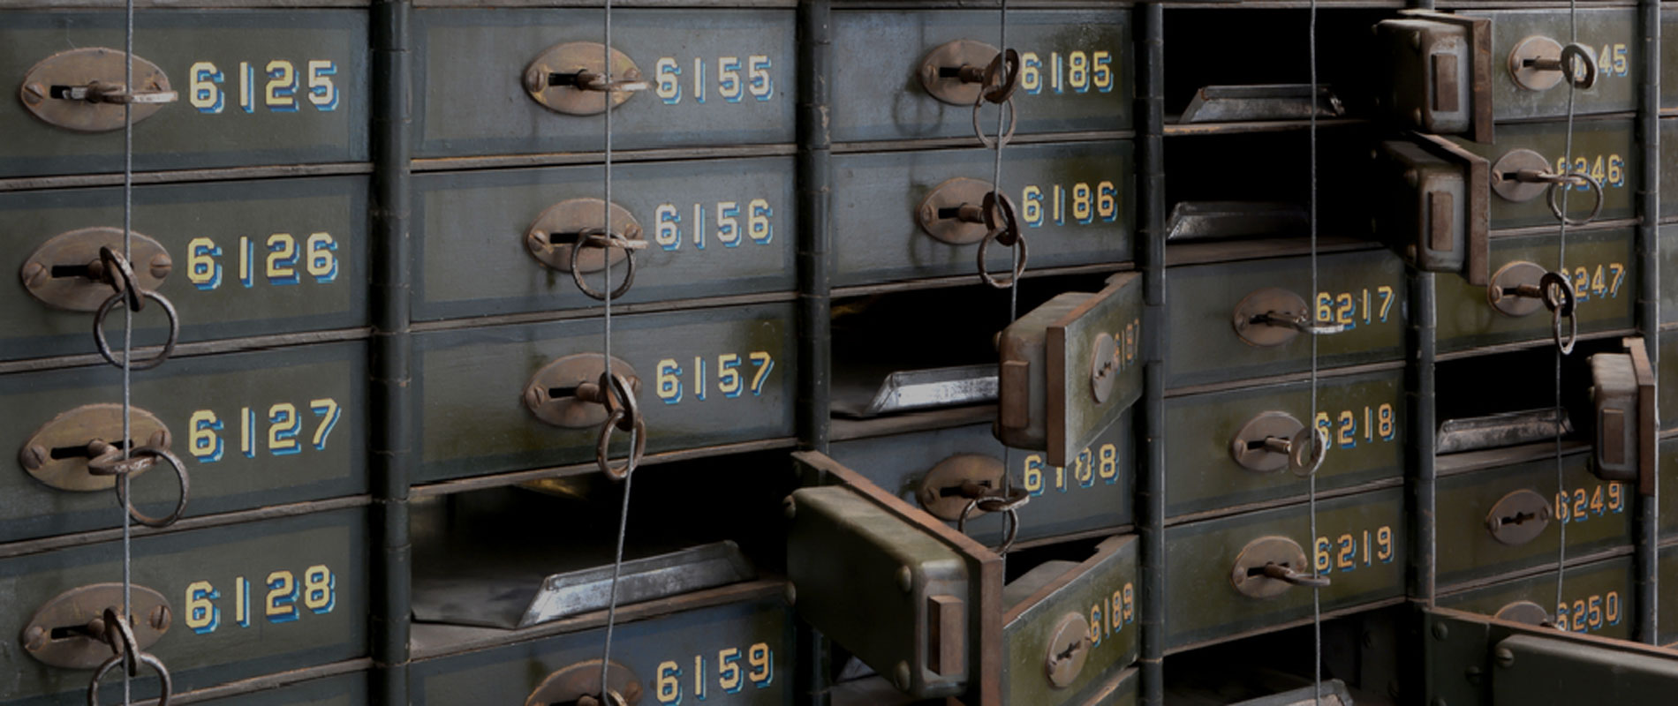
Hash Tables
HashSet<T> and SortedSet<T>

Slide 17
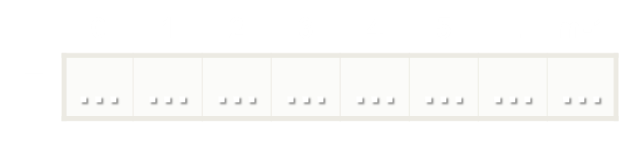
What is Hash Table?
A hash table is an array that holds a set of (key, value) pairs
The process of mapping a key to a position in a table is called hashing
Hash function h: k → 0 … m-1
h(k)
Hash table of size m

Slide 18
Hashing
A hash function h(k) maps keys to positions:
h: k → 0 … m-1
For any value k in the key range and some hash function h we have
h(k) = p && 0 ≤ p < m
h(k)

Slide 19
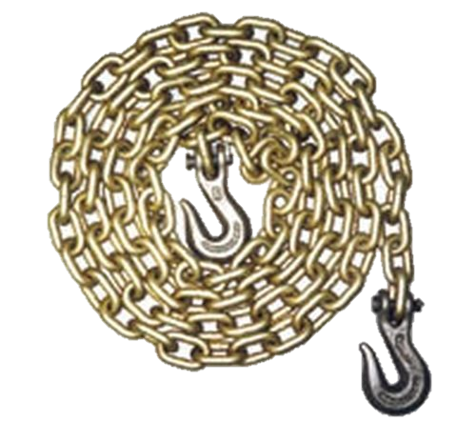
Collisions in Hash Tables
A collision is the situation when different keys have the same hash value
h(k₁) = h(k₂) for k₁ ≠ k₂
Several collisions resolution strategies exist
Chaining in a list
Using the neighboring slots (linear probing)
Re-hashing (second hash function)

Slide 20
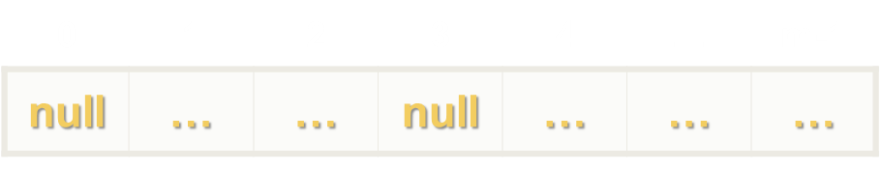
Collisions in Hash Tables
h("Pesho") = 4
h("Kiro") = 2
h("Mimi") = 1 collision
h("Ivan") = 2
h("Lili") = m-1
Chaining elements in case of collision
Mimi
Kiro
Pesho
Lili
null
Ivan
null
null

Slide 21
Problem: Set vs List Performance
Check performance for sets and lists, when you using similar operations like:
Add
Contains
Remove
This problem is for showing you how to measure your code and there is no need to submit this in judge

Slide 22
Solution: Set vs List Performance
HashSet<string> set = new HashSet<string>();
List<string> list = new List<string>();
var specialString = GetRandomString();
var random = new Random();
int number = random.Next(0, 1000000);
AddToCollection(specialString, number, set);
AddToCollection(specialString, number, list);
SearchInCollection(specialString, set);
SearchInCollection(specialString, list);
RemoveFromCollection(specialString, set);
RemoveFromCollection(specialString, list);

Slide 23
Solution: Set vs List Performance (2)
var watch = System.Diagnostics.Stopwatch.StartNew();
for (int i = 0; i < 1000000; i++)
{
if (i == number)
collection.Add(special);
else
collection.Add(GetRandomString());
}
Console.WriteLine(collection.Count);
watch.Stop();
Console.WriteLine($"Adding elements to
{collection.GetType()} for {watch.ElapsedTicks}");

Slide 24
Solution: Set vs List Performance (3)
var watch = System.Diagnostics.Stopwatch.StartNew();
for (int i = 0; i < 1000000; i++)
{
if (i == number)
collection.Add(special);
else
collection.Add(GetRandomString());
}
Console.WriteLine(collection.Count);
watch.Stop();
Console.WriteLine($"Adding elements to
{collection.GetType()} for {watch.ElapsedTicks}");

Slide 25
Solution: Set vs List Performance (4)
private static void SearchInCollection(string specialString, ICollection<string> collection)
{
var watch = System.Diagnostics.Stopwatch.StartNew();
bool exists = collection.Contains(specialString);
watch.Stop(); //TODO: Print time
}
public static string GetRandomString()
{
string path = Path.GetRandomFileName();
path = path.Replace(".", "");
return path;
}

Slide 26
Dictionary<Key, Value>
иван
гошо
пешо
0845-346-356
2350-452-167
1255-377-131
Associative Arrays

Slide 27
Associative Arrays (Dictionaries)
Associative arrays are arrays indexed by keys
Not by the numbers 0, 1, 2, …
Hold a set of pairs <key, value>
Traditional array
Associative array
key
value
key
0 1 2 3 4
John Smith | +1-555-8976
Lisa Smith | +1-555-1234
Sam Doe | +1-555-5030
value
8 | -3 | 12 | 408 | 33

Slide 28
Dictionary<K, V> – Add()
Dictionary<string, string>
Pesho
0881-123-987
Gosho
0881-123-789
Alice
0881-123-978
Hash Function
Key Value

Slide 29
Dictionary<K, V> – Remove()
Dictionary<string, string>
Pesho
Pesho
0881-123-987
Gosho
0881-123-789
Hash Function
Alice
0881-123-978
Key Value

Slide 30
SortedDictionary<K, V> – Example
SortedDictionary
<string, string>
Alice
+359-899-55-592
Pesho
0881-123-987
Key Value

Slide 31
Looping through dictionaries
For Each
KeyValuePair<string, string> keyValuePair in
Dictionary<string, string>
Pesho
Pesho
0881-123-987
0881-123-987
Gosho
Gosho
0881-456-987
0881-456-987
Alice
+359-899-55-592
Alice
+359-899-55-592
.Key .Value
Notes:
foreach (KeyValuePair<string, int> keyValuePair in phonebook)
{
Console.WriteLine("name: {0}, mobile number: {1}",
keyValuePair.Key,
keyValuePair.Value);
}

Slide 32
Dictionary<K, V> and SortedDictionary<K, V>
Have property Count – the number of key-value pairs
Keys – a set of unique keys
Values – a collection of all values
Basic operations – Add(), Remove(), Clear()
Boolean methods:
ContainsKey() – checks if a key is present in the dictionary
ContainsValue() – checks if a value is present in the dictionary

Slide 33
Problem: Count Same Values in Array
Write a program that counts in a given array of double values the number of occurrences of each value.
-2.5 | 4 | 4 | 3 | -2.5 | -5.5 | 4 | 3 | 3 | -2.5 | 3
-2.5 | 3 – times
4 | 3 – times
-5.5 | 1 – times
3 | 4 – times

Slide 34
Solution: Count Same Values in Array
var input = Console.ReadLine();
var numbers = input.Split(new char[] {' '},
StringSplitOptions.RemoveEmptyEntries)
.Select(double.Parse).ToArray();
var dictionary = new SortedDictionary<double, int>();
foreach (var number in numbers)
{
if (!dictionary.ContainsKey(number))
dictionary.Add(number, 1);
else
dictionary[number]++;
}
//TODO: Print results
https://judge.softuni.bg/Contests/589/Sets-and-Dictionaries-Lab

Slide 35
Problem: Academy Graduation
Write a program that:
Read list of students and their score for some courses
Print on console sorted list with average score for each student
Student | Java Advanced | Java OOP
Gosho | 3.75 | 5
Mara | 4.25 | 6
Pesho | 6 | 4.5
Student | Average
Gosho | 4,375
Mara | 5,125
Pesho | 7,25

Slide 36
Solution: Count Same Values in Array
var number = int.Parse(Console.ReadLine());
var students = new SortedDictionary<string, List<double>> ();
for (int i = 0; i < number; i++)
{
var student = Console.ReadLine();
var results = Console.ReadLine()
.Split(new char[] {' '}, StringSplitOptions.RemoveEmptyEntries)
.Select(n => double.Parse(n, CultureInfo.InvariantCulture)).ToList();
students.Add(student, results);
}
https://judge.softuni.bg/Contests/589/Sets-and-Dictionaries-Lab

Slide 37
Associative Arrays
Exercises in class

Slide 38

Summary
The HashSet<T> and SortedSet<T> hold unique elements and are very fast
Dictionary<K, V> is an associative array where a value is accessed by its key

Slide 39







Sets and Dictionaries
https://softuni.bg/trainings/1633/csharp-advanced-may-2017

Slide 40

License
This course (slides, examples, demos, videos, homework, etc.) is licensed under the "Creative Commons Attribution-NonCommercial-ShareAlike 4.0 International" license
Attribution: this work may contain portions from
"C# Fundamentals – Part 1" course by Telerik Academy under CC-BY-NC-SA license
"C# Fundamentals – Part 2" course by Telerik Academy under CC-BY-NC-SA license

Slide 41






Free Trainings @ Software University
Software University Foundation – softuni.org
Software University – High-Quality Education, Profession and Job for Software Developers
softuni.bg
Software University @ Facebook
facebook.com/SoftwareUniversity
Software University @ YouTube
youtube.com/SoftwareUniversity
Software University Forums – forum.softuni.bg

